Slide 1
Global Manufacturing Strategy Introduction Class
Ben Koo
March, 4, 2015

Slide 2
Outline
Self Introduction:40~60 min
Group-based Learning
Collaboration Tool: GitLab
Course Introduction
Learning Objectives: Context, Motivation, Execution, Correction
Book and Video Reviews: see references
Course Projects: team-based
Team Product: An electronic strategy document
Personal Product: A Personal “Biz Strategy”
Social Activities: Company tours/Hackerspace

Slide 3
Self Introduction
Everyone speaks 1~2 minutes
Identity: Name, Country and City Origin,
Expertise: Undergraduate Major and Now
Interests on Global Manufacturing Strategy
Hobbies and Specialties

Slide 4
First 4 weeks
1. Intro, Book List, and Team Building
2. Git Game, China videos by Jacque, and The Start-up Nation
3. Global Maker/Hackerspace Movement
4. Clockspeed, Wikinomics and Crowd Funding

Slide 5
Remaining weeks
Week 1~4 Content Distribution, Discussion
Week 5~8 Project Proposal Workshops
Week 9~12 Evaluation and Integration
Week 13~16 Refinement and Final Demos

Slide 6
What will you learn?
Making sense out of a highly complex problem using metaphors, facts and tools.

Slide 7
Learning Objectives
Learn to become aware of the
Opportunities
Decision-Making Practices
Analyze the outcomes
in a Globalized Manufacturing Environment
Learning Outcomes:
An Industry Analysis Report(IAR) published digitally
Including process data, weekly blogs, surveys, and data analytics, a booklet, a website (using Github and Gitbook.io)
Manufacture at least one physical object relating to your IAR
Weekly Learning Reflection on http://toyhouse.cc

Slide 8
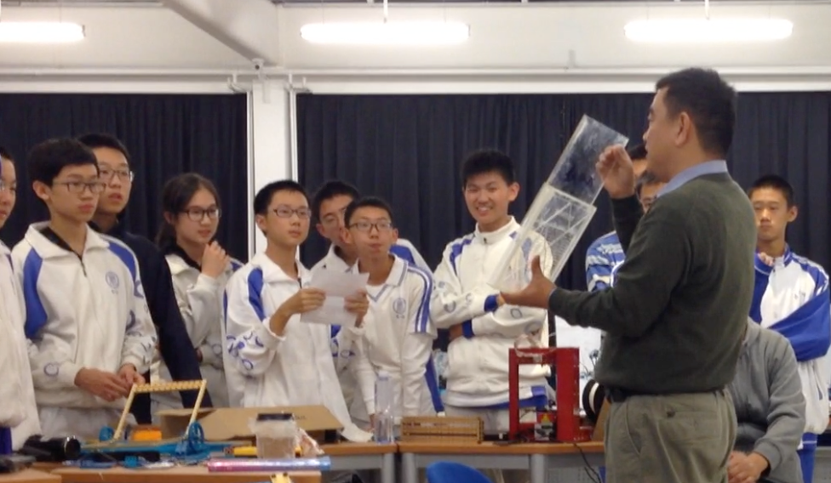

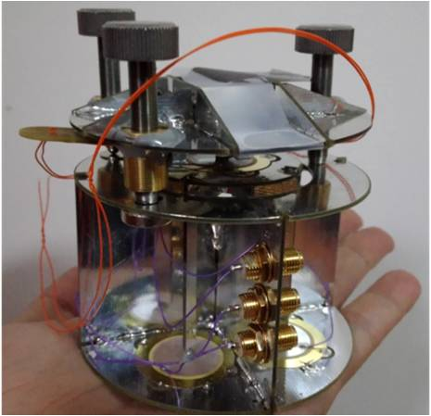

Digitized Publication Results
From writing Constitutions of
XLP-based Learning Spaces
to building Atomic Force Microscopes and
developing Digital Nations

Slide 9
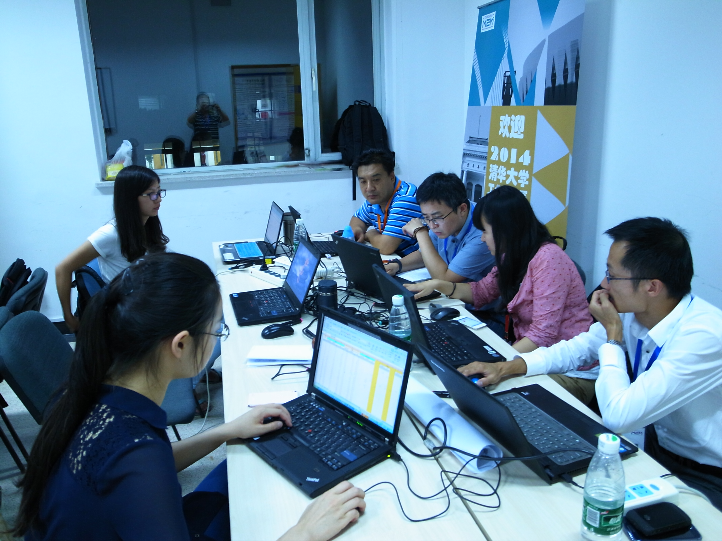

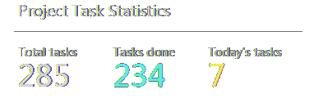
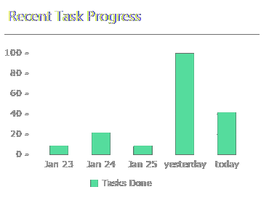
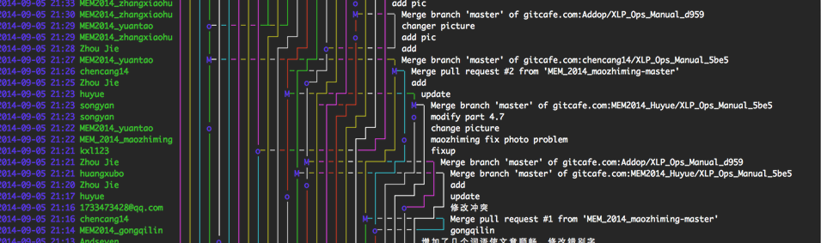

Visualizing Results
In-process and end results are shown in the digital publishing process

Slide 10
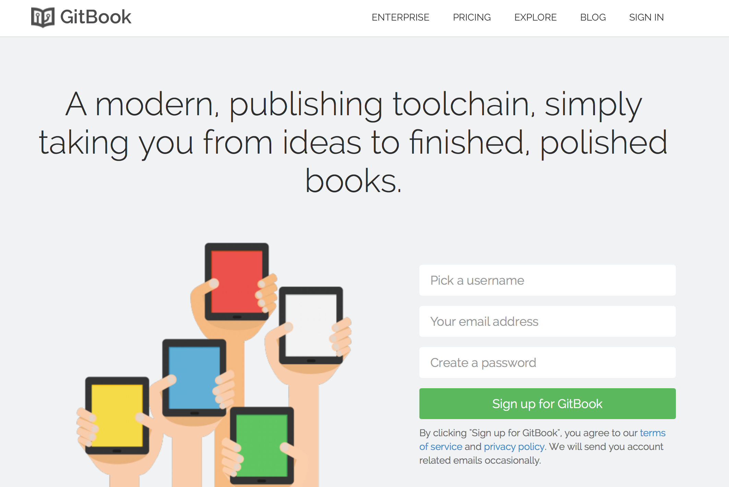
Dedicated Publishing Tools

Slide 11
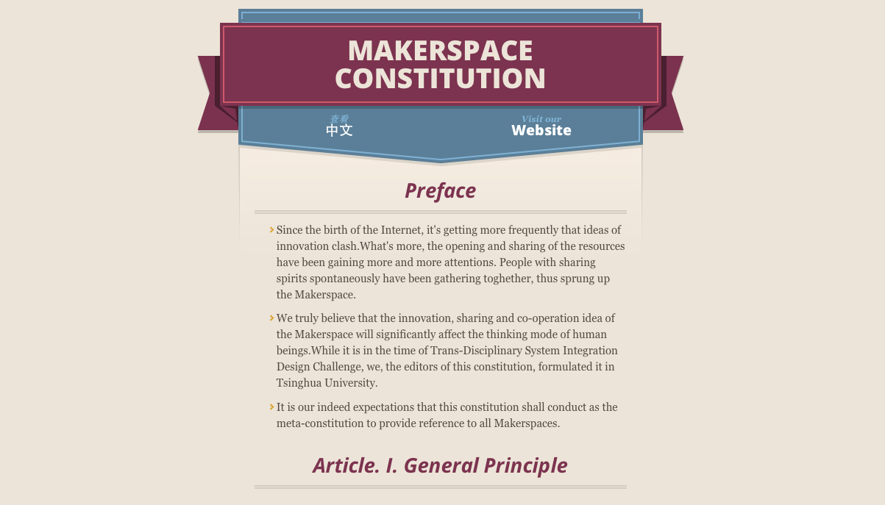
Digital Manufacturing Workflow
Content produced through Git/Gitbook publishing process can be transferred automatically to a Website

Slide 12
Learning Elements
Context: Past, Current and Future Events
Story Telling：(See Roslin and Anderson Videos)
Motivation: Identify Stakeholders, Resources, Structures of Interactions
Logic Model Construction
Execution: Your own projects, Case Studies, Anti-Patterns, Well-Known Practice,
Correction: Incremental, Mid-Term, Final

Slide 13
Learning Strategy
Time Domain: (History)
Regulations/Policies
Agencies
Personalities
Spatial Domain: (Landscape)
Jurisdiction Territories
Execution/Enforcement Locations (Factory Dist.)
Residences of the personalities

Slide 14
Basic Measurements
Time:
Partially Ordered Events
Space:
Structured Information Content
Unstructured Information Content
Uncertainty
Probability Measures
Possibility Measures
Plausibility Models

Slide 15
How to customize the world for you?
Distributed Architectures
Team-based Learning
Git
Blockchain-related technologies
Coordination Technologies
Communication Tools, Contracts, Enforcements

Slide 16
Design by Contract
When designing a program
First specify the Pre and Post Conditions
Then identify a “Strategy” to satisfy these conditions
When designing a course
First specify the Pre-requisites and Post-products
Then conduct learning activities to satisfy needs

Slide 17
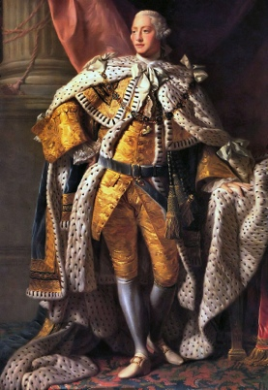
the thirteen united States of America
Jefferson et al
July 4th, 1776
Final
George III, King of the United Kingdom of Great Britain and Ireland
Declare Independence
Current Inhabitants
Future Immigrants
Safety
Happiness
British Brethren
Rest of Mankind
An intruder and a stranger
Charters
Law
Land
Fellow citizens
Legislative
Judiciary
Life
Fortune
Honor
Taxes
Trade
Appropriations of lands

Slide 18

















Logic Model
INPUTS
ACTIVITIES
PARTICIPATION
OUTCOMES
Sponsors
Money
Time
Facilities
Materials
Mission-Based Game in the Microcosm of the Society
Digital Publishing Process
Learning Activity Design Sessions
Product Development
Students,
Teachers, General Public
Challenge Designers
Mission Executors
Industry 4.0 Digital Literacy
Open-Source
Crowd-Learning
Distributed Intelligence
Discover Untapped Potentials

Slide 19
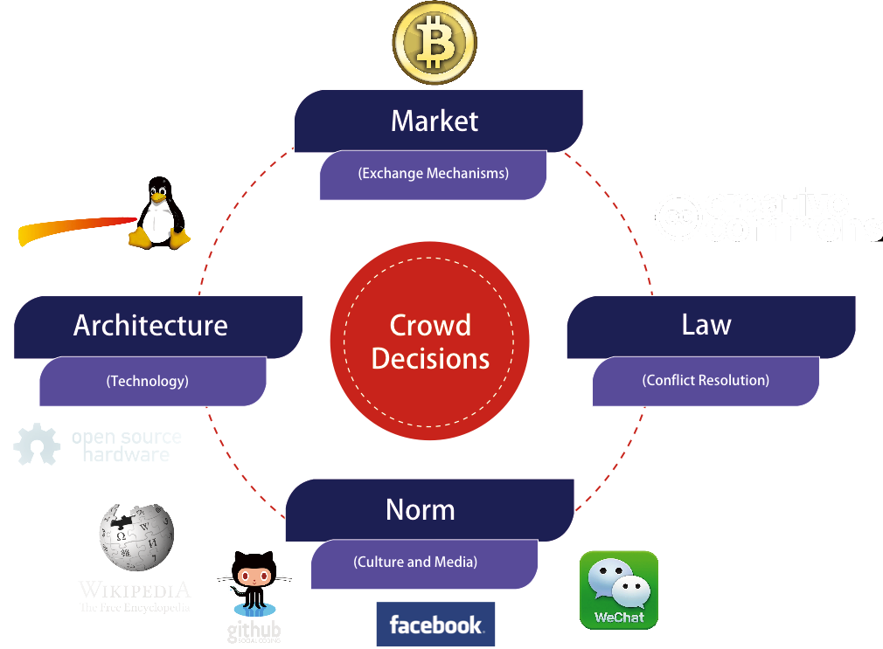


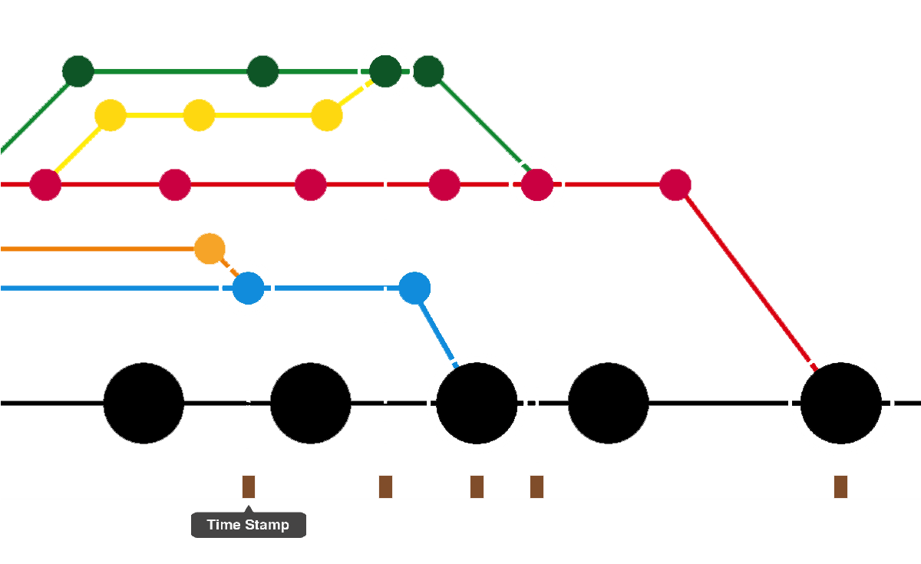
Microcosm of Society
Using the Four Forces Model..
..with Guided Just-In-Time Teaching for Every Stage of Activity
Idea Generation and Goal Definition
Planning and Management
Distributed Content Management
Product Development
Digital Publishing

Slide 20
Using Networked Collaboration as a Publishing Process
Digital Publishing
Product Development
Distributed Content Management
Demo Product
Planning and Management
Web Platforms
Modeling Tools
(Programming Languages, AutoCAD, PhotoShop, InDesign)
Media Events
Idea Generation and Goal Definition
Content Distribution Protocol (Git)
Data Collection
Devices (Cameras, Microphones,
Input Devices)
Prototyping Tools
(Lego, Makeblock)
Story Boarding
(PowerPoint)
Computation Resources
Time Tables
(SmartSheet)
Testing Instruments
635 Method
Integration Tools
(Gitbook)
Mission Statement
Multi-Level Design Contracts (XMind)

Slide 21

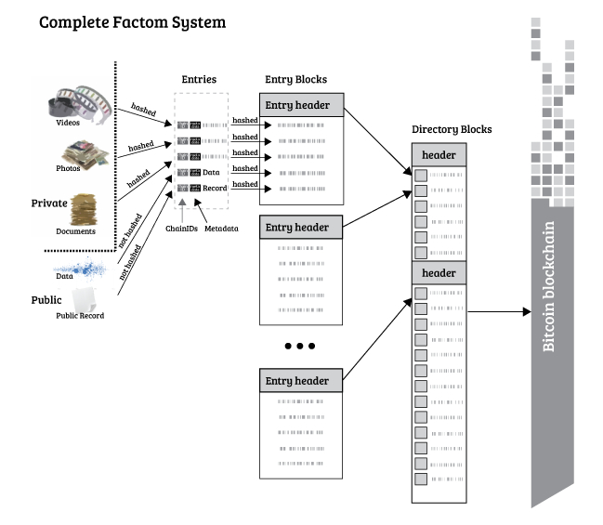






Using Distributed Technology
Distributed
Secure
Flexible
Public Witnessing

Slide 22













International Presence
Through iPodia Alliance XLP operates in multiple sites internationally crossing the disciplinary, institutional, physical and cultural boundaries.

Slide 23
References
Industries 4.0:
Makers: The New Industry Revolution, Chris Anderson
The Start-up Nation, Dan Senor & Saul Singer
When China Rules the World, Martin Jacques (Book, TED and Youtube video)
Clockspeed : Winning Industry Control in the Age of Temporary Advantage, Charles Fine
Wikinomics, Don Tapscott and Tony Williams

